Slide 1
TableauWork- Farm Plan : Program Feedback
File created on: 3/3/22 2:24:55 PM EST

Slide 2
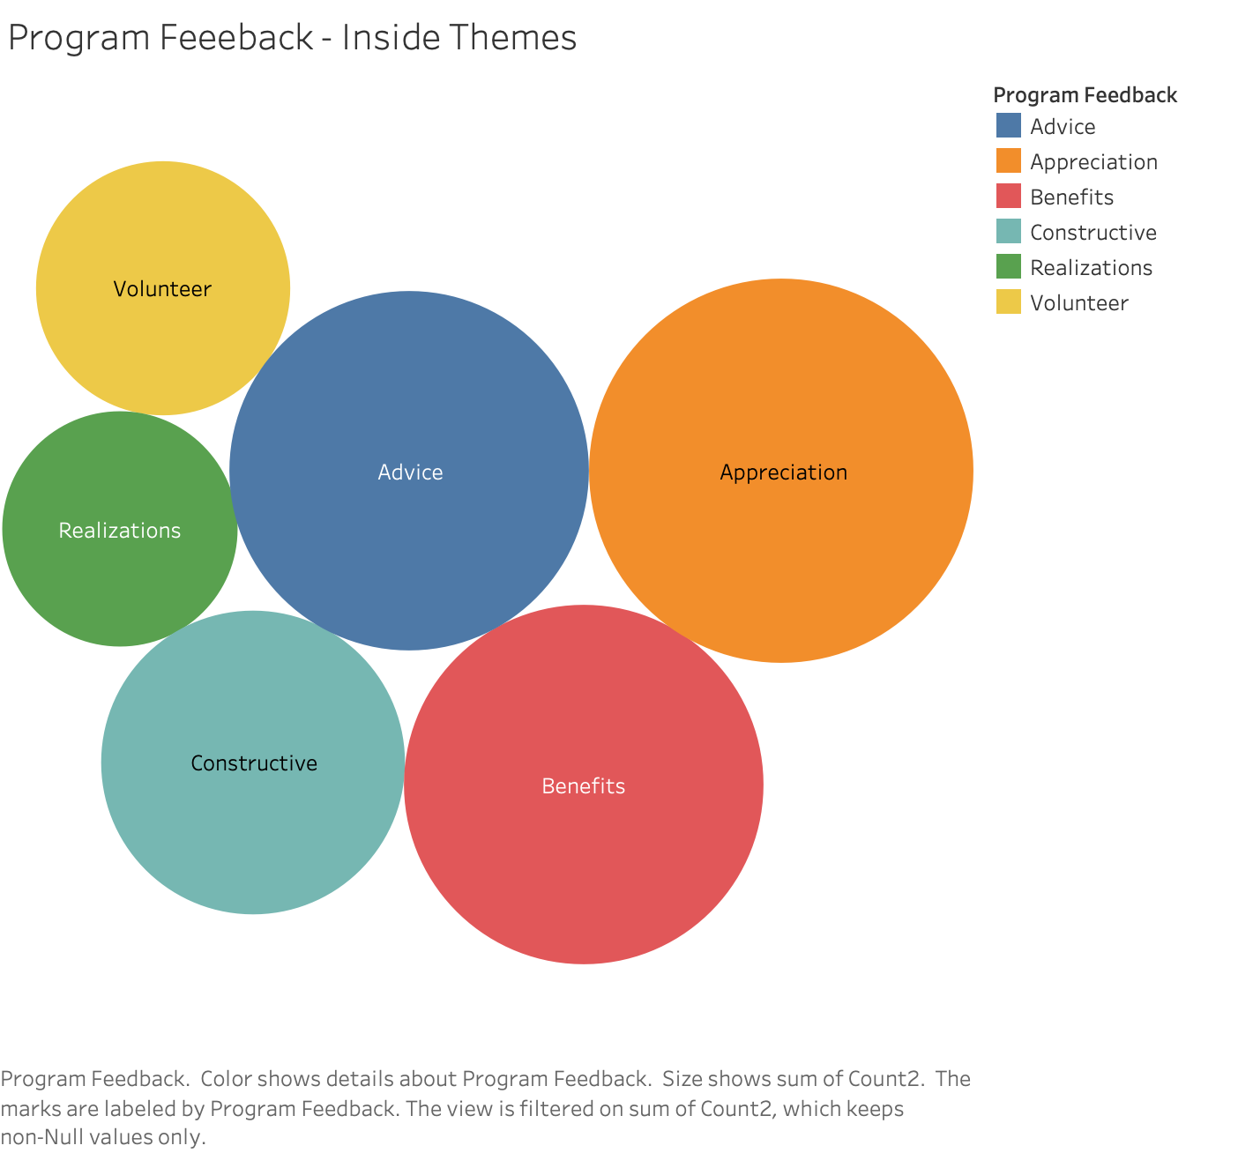

Slide 3
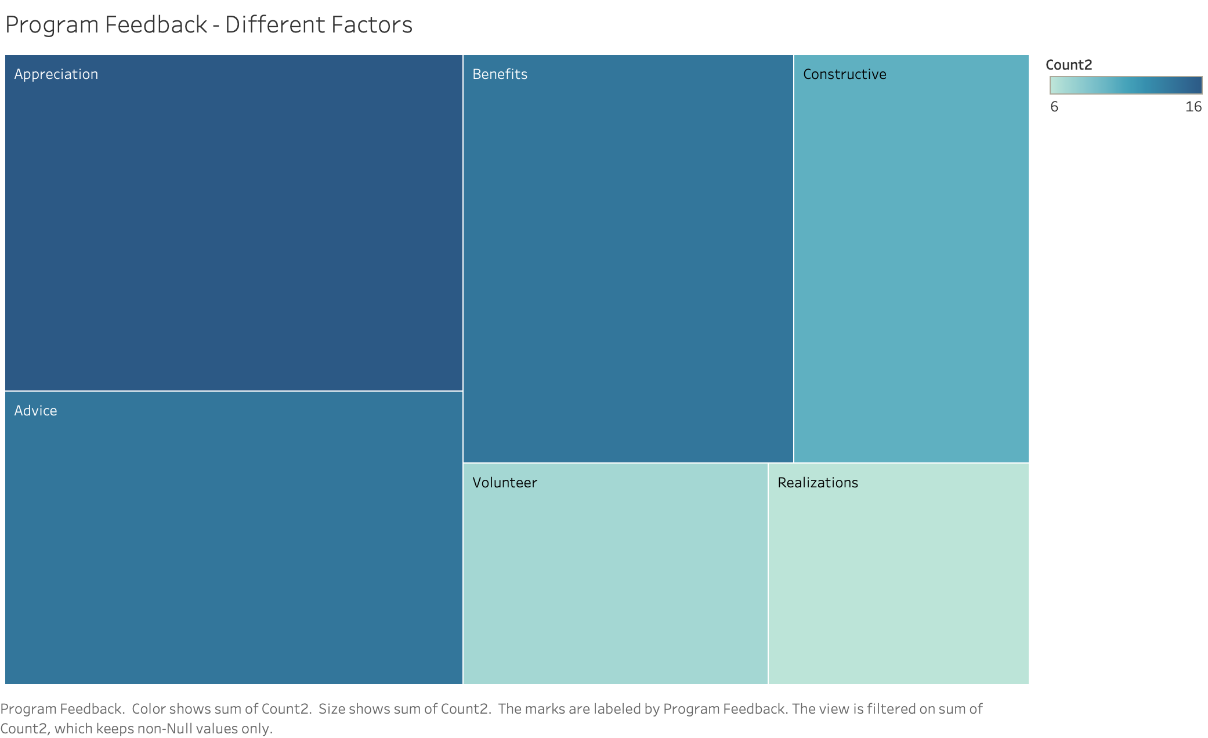

Slide 4
